Slide 1

RESUME SESSION
ANURADHA SAHU
SENIOR FACULTY

Slide 2
RESUME FORMAT
1.HEADER
NAME
TITLE
(3 LINE SUMMARY)
2. TECHNICAL SKILLS
3.PROJECTS
4.EDUCATION TRAININGS
5.WORK EXPERIENCE

Slide 3
DO’S
Single page only.
Proper headings.
2-3 bullet points for each project./Education
The name should be 14px and other details should be 12px.
After the name gives the title.
Consistent fonts and headings.
The single column only.

Slide 4
DONT’S
Career objective.
Personal details
Grammar mistakes
Spelling mistakes
No soft skill section

Slide 5
SUMMARY
This section is for those candidates if experience in a different industry.
The summary should be without a heading.
For example:
Mechanical branch
Solid command of technologies, tools, and best practices in designing mechanical equipment using AutoCAD, SolidWorks, and engineering drawings. Able to design and fabricate tooling and mechanical test fixtures.

Slide 6
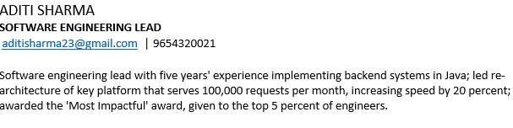

Slide 7
PROJECT
Those candidates who have done projects.
Mention the recent two projects.
It should be the proper project mainly from the advanced level (for freshers).

Slide 8
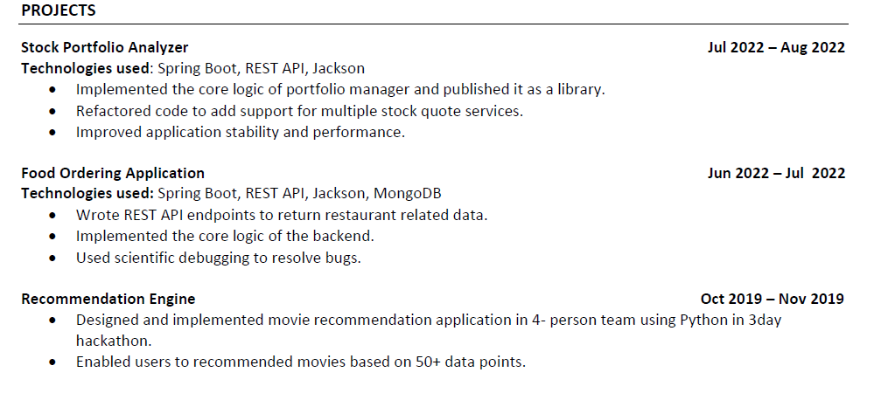

Slide 9
EDUCATION
Mention the training in the Trisect Institute, Noida.
Your college degree with university name.
Awards and Achievements.
Training certificates.

Slide 10
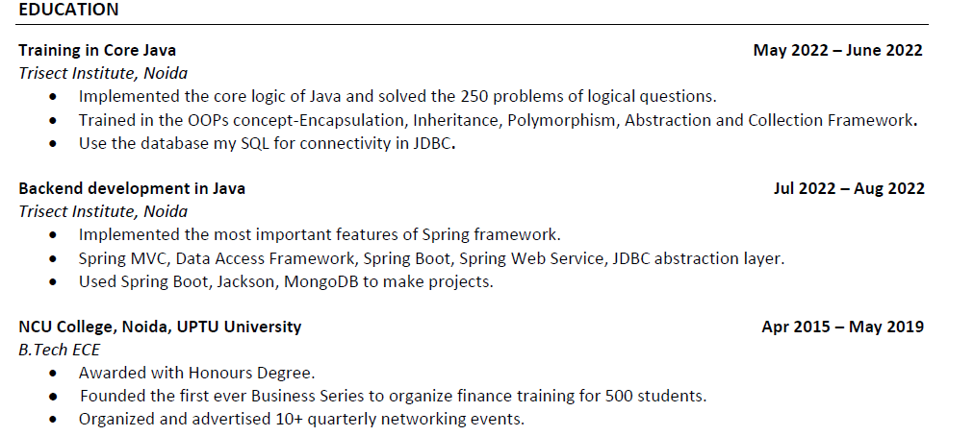

Slide 11
TECHNICAL SKILLS
Whatever computer languages you know can be mentioned in this section.
The database used in the projects.
Web Technologies can be mentioned you know well.
Operating System
Development tools you used.

Slide 12
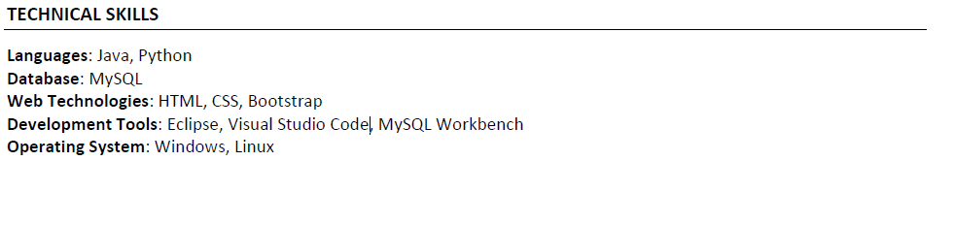

Slide 13
WORK EXPERIENCE
Mention the total work experience in a single line.
If you have recent years of work experience in any field.
Recently two companies’ work experience you can mention.

Slide 14
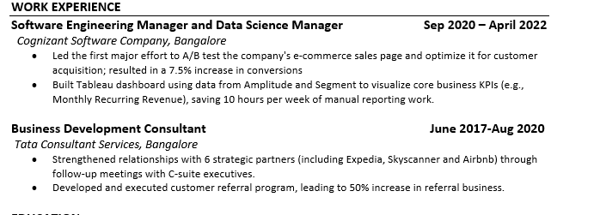

Slide 15
WORK EXPERIENCE
If you have worked in either Tech support/Db/Network or testing.
Then for semi-relevant work the order of resume like:
Work Experience
Project
Tech skills
Education
Exceptions: NIT/IIT college pass out can mention Education section should be first.

Slide 16
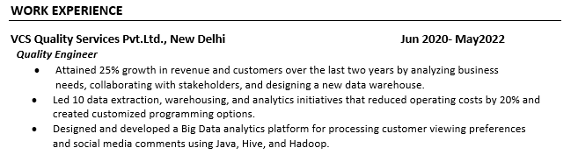

Slide 17
DON’T MENTION ANY OBSTACLES CREATING POINT
Current Location
Pic- if doing professional pic only
Personal details
Gap years
Percentage
Backs
Work gaps.

Slide 18
RESUME FORMAT FOR FRESHERS
ORDER:
Name
Title
Email id and Mobile no.
Projects
Education
Technical Skills

Slide 19
RESUME FORMAT FOR EXPERIENCE
ORDER:
Name
Title
Email id and Mobile no.
Summary
Work Experience
Projects
Education
Technical Skills

Slide 20
RESUME FORMAT FOR NON-IT EXPERIENCE
ORDER:
Name
Title
Email id and Mobile no
Summary
Projects
Work Experience
Education
Technical Skills

Slide 21
THANKYOU

